Slide 1
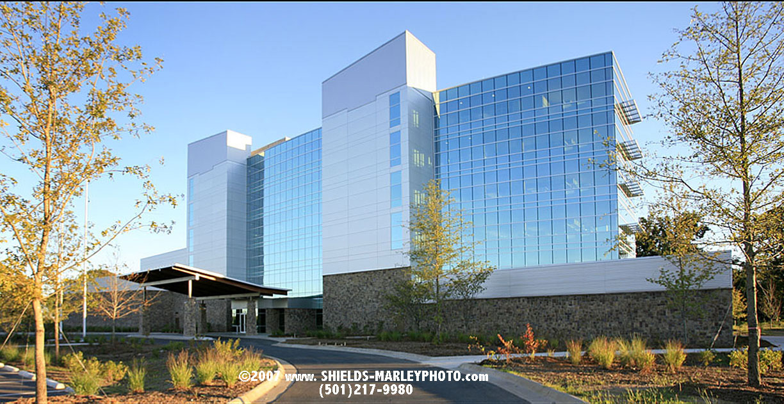

Reset recycling in Arkansas
Division of environmental quality

Slide 2
Swifr program

Slide 3
The EPA’s Solid Waste Infrastructure for Recycling (SWIFR) program provides grants to states and tribes to:
improve post-consumer materials management and infrastructure;
support improvements to local post-consumer materials management and recycling programs; and
assist local waste management authorities in making improvements to local waste management systems.

Slide 4
Statewide solid waste management plan

Slide 5
Statewide solid waste management plan
Act 1376 of 2001 – Division of Environmental Quality has the responsibility of developing the Statewide Solid Waste Management Plan (SSWMP), which gives emphasis to regional planning.
Regional Solid Waste Management Boards address the solid waste needs of the state within their geographical area.
The development and implementation of a SSWMP is necessary to maximize the efficiency of regional solid waste management systems.
The SSWMP establishes minimum requirements for all regional solid waste management plans, including requirements for: strategic planning; reporting; public notice and participation; services; and solutions to problems and issues.

Slide 6
Statewide solid waste management plan (cont.)
Six (6) major goal areas were established:
  Collection
  Disposal
  Recycling
  Waste Reduction
  Special Materials
  Education
The development and implementation of a SSWMP is necessary to maximize the efficiency of regional solid waste management systems.
First plan under this legislation was implemented in 2003. The most recent revision was 2014.

Slide 7
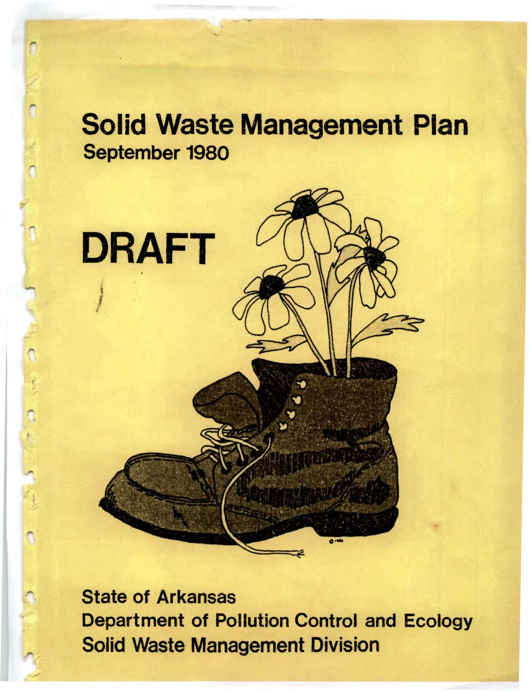
Previous SSWMP
1980

Slide 8
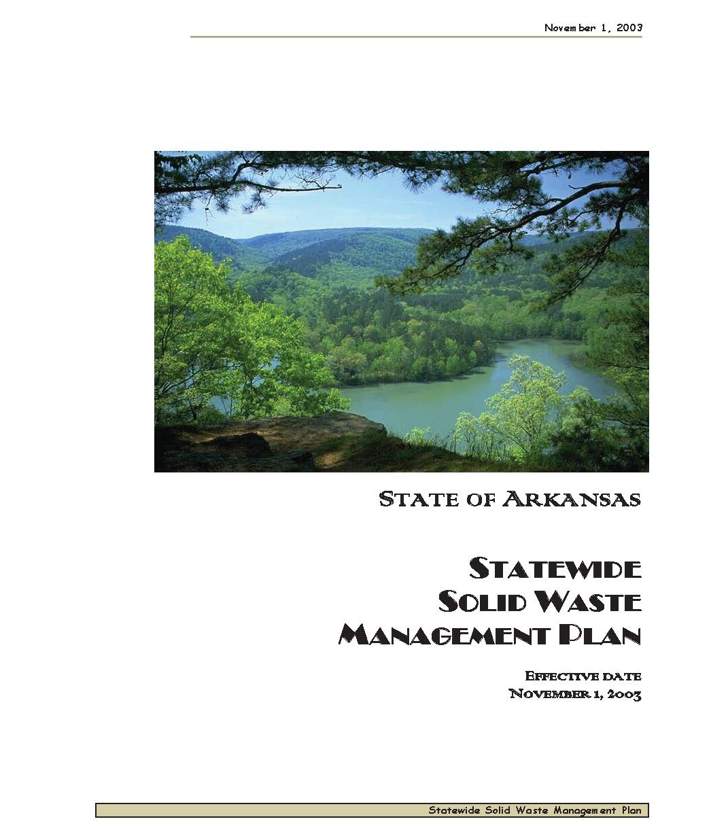
Previous SSWMP
2003

Slide 9


WHY UPDATE THE PLAN NOW?
The Solid Waste Management Plan is old and outdated. It hasn’t been updated since 2014!

Slide 10
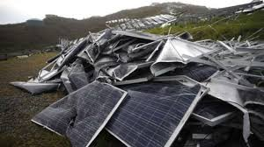
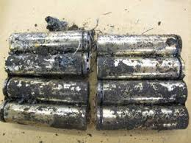
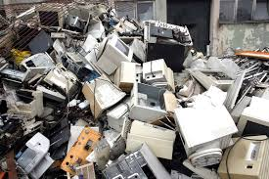
WHY UPDATE THE PLAN NOW?
New recycling challenges
Waste Solar Panels
Lithium-Ion Battery disposal
E-Waste disposal

Slide 11
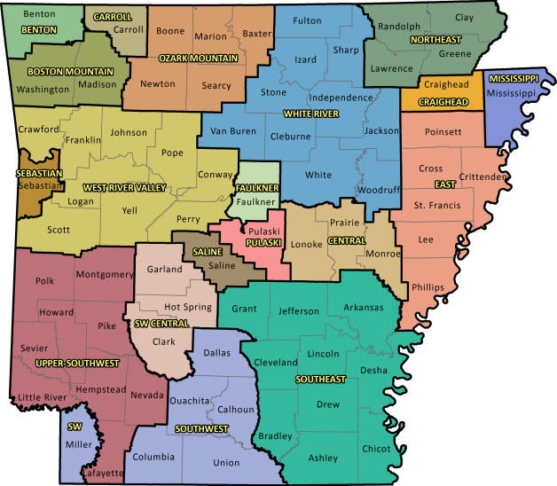
WHY UPDATE THE PLAN NOW?
The planning districts have changed.
There were 16 Regional Solid Waste Management Districts (RSWMD) when the plan was first developed; now there are 19.

Slide 12
Progress & next steps

Slide 13
Progress & next steps
01
02
03
04
Send out survey
Conduct Stakeholder meetings throughout the state
Analyze survey results and public input
Update the solidwaste management plan

Slide 14
Survey Questions & results

Slide 15
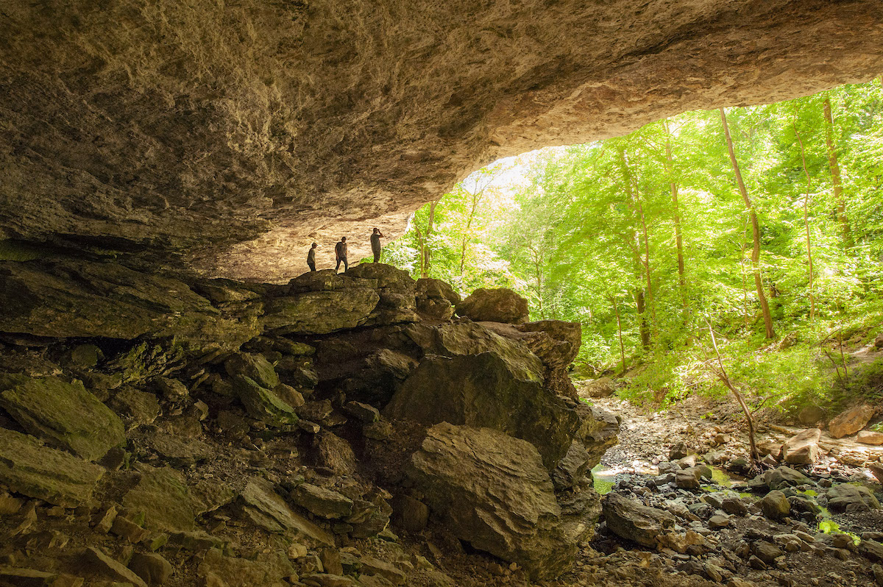
SURVEY QUESTIONS
What are some successful recycling opportunities you have seen or been a part of in Arkansas?
What areas of the state do you believe lack recycling?
How do you believe recycling and solid waste management can be improved?
What are effective ways of educating others on how to recycle?
What would engage you and those around you to recycle more at work or at home?

Slide 16
Areas of Focus based on results
01
02
03
04
Education
Rural Access
BENEFITS
GOVT Action
Advertise!
Focus on awareness
School Programs
Informing public on how and what to recycle
Increase access in rural areas/outside of cities
Branch out on successes in curbside
Make it easy!
Incentives
Economic (cost savings)
Convenience
Environmental Impacts
Quality of life
Legislative changes
Grants/Funding opportunities
Bring back education programs
Statewide campaigns

Slide 17
Out of 104 total surveys*

Slide 18
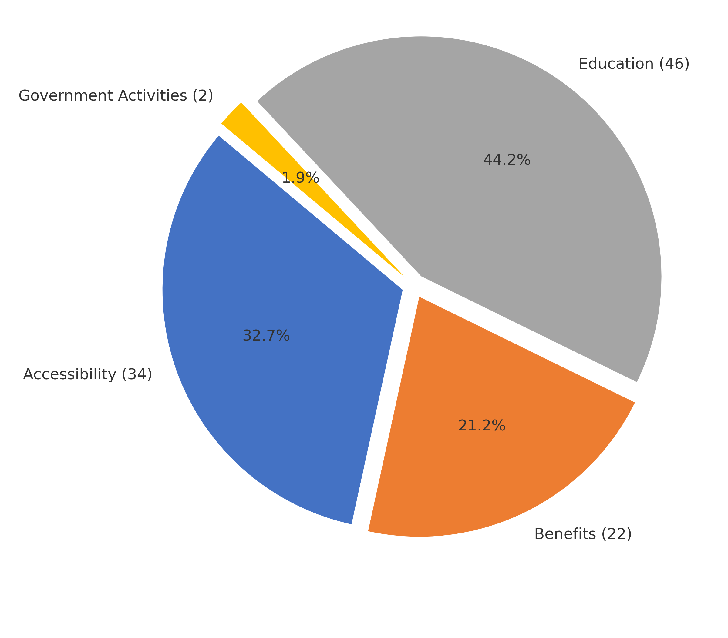
Categorization of Survey Responses

Slide 19

CALLING ALL VOLUNTEERS
Solid Waste Management Planning
DEQ is seeking volunteer participants to help brainstorm and draft recommendations for:
2026 Arkansas Statewide Solid Waste Management Plan
Minimum Guidelines for the 2026 Regional Solid Waste Management Plans
Six (6) Subcommittees (5 members each) will be formed:
Needs Assessment
Collection
Disposal
Recycling
Special Materials
Education & Public Participation

Slide 20
CALLING ALL VOLUNTEERS
Solid Waste Management Planning
Meeting Schedule:
Format: In-person or virtual
Timeline: September – December 2025
Goal: Present recommendations to DEQ and the public by January 2026

Slide 21
KEEP IN TOUCH
DEQ – Enterprise services
5301 Northshore Drive
North Little Rock, AR, 72118
EMAIL
EE.EnterpriseGroup@arkansas.gov
WEBSITE
https://www.adeq.state.ar.us/
@AREnergyEnvironment
@ArkansasEE

Slide 22
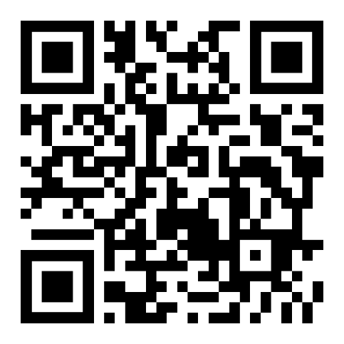
We want your input!!
But hurry – survey closes august 31st
Please complete our brief survey. Scan the QR Code below!

